Slide 1

Project Iterations

Slide 2

Iterate iterate iterate
Two week iterations
Repeat… 5 iterations
Plan
Implement
Review
This is an Agile-like process.
Lecture on that soon.

Slide 3
Planning!
Talk to your group
Decide what needs to be done over 2 weeks
Big picture: Is this 1/5th of the project?
Break up work into small tasks
Assign tasks to individuals
3-6 tasks per person is a rough estimate
I’ll give you some class time to meet
No, 3 minor bugs or tiny “features” doesn’t count!

Slide 4
Example!
This iteration, I will…
Connect the create account page to the db
Implement the backend functionality for logging in
Update each page to use user info
Fix bug that occurs when no items exist
Bad example: I will use Foobar class in Xyz class
Too small
Describes code, not functionality

Slide 5
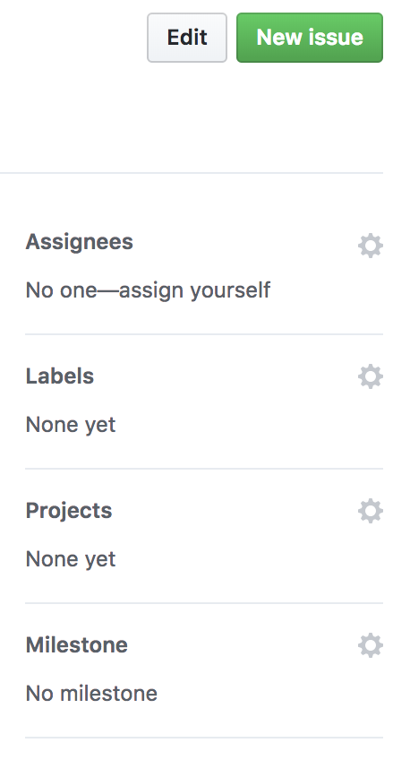
Tracking Tasks
Use GitHub’s Issue feature
Helps team keep track
Graded based on this!!!
No issues? Zero ☹
Assign it!
Iteration #

Slide 6
Link commits to issues!
Use the issue # in the commit message
E.g., “Adds the button for #15”
Can link multiple commits to the issue
With last commit, close it
E.g., ”Implements user login. Fixes #15”

Slide 7
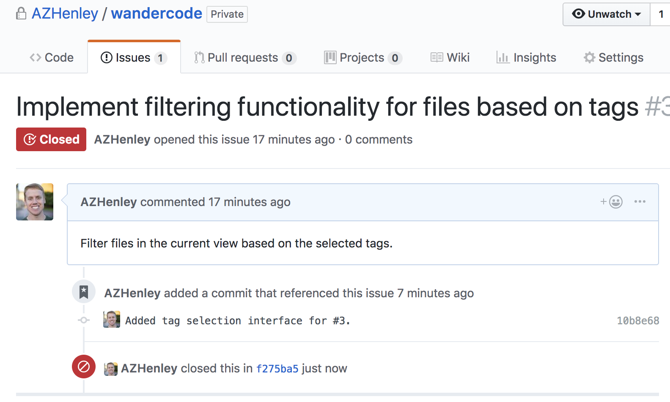
Link commits to issues!

Slide 8
Grading
Project is 50% of overall grade
30% individual
6% per iteration
20% group milestones
First demo: basic functionality, 10%
Second demo, 10%

Slide 9
First iteration!
Starts Thursday 9/6
Have issues created by class time
Repositories will be setup early next week
Ends Thursday 9/20

Slide 10
Demo Days
Middle and end of semester (iteration 3 and 5)
5 minutes to demo tool to me
Will be checking features from previous iterations
Reserve the right to re-grade previous iterations!
Your responsibility to have it working on demo day

Slide 11
My advice
Meet with your group! Setup a group chat
Create issues for all basic features of your app
Schedule to have them completed by iteration 3
Use iteration 4 & 5 for bugs, final features, polishing
Estimating is hard

